Slide 1
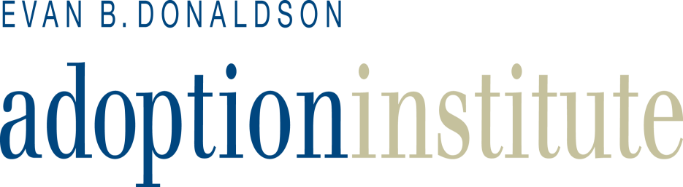
Scams and Scruples:
What Should We Do About Unethical Adoptions?
American Adoption Congress
April 28, 2012
Adam Pertman, Executive Director www.adoptioninstitute.org www.adampertman.com info@adoptioninstitute.org

Slide 2
Our Mission
The Evan B. Donaldson Adoption Institute’s mission is to provide leadership that improves laws, policies, and practices – through sound research, education and advocacy – in order to better the lives of everyone touched by adoption.
Our Principles and Values
Every child needs and deserves a permanent family.
Adoption is a natural, beneficial way to form a family.
Everyone’s needs in the extended family of adoption must be respected.
Openness and honesty are critical; deception and coercion are undermining.
Practices must adhere to high ethical standards and be free from profiteering.

Slide 3
A Sampling of the Adoption Institute’s Projects, Programs and Recent Initiatives
Untangling the Web: Adoption on the Internet (November 2012)
Expanding Resources for Children I, II and III: Gay and Lesbian Adoption
Never Too Old: Achieving Permanency for Older Youth in Foster Care
Keeping the Promise: The Critical Need for Post-Adoption Services
For the Records I and II: Restoring a Legal Right to Adopted Adults
Beyond Culture Camp: Promoting Healthy Identity in Adoption
Safeguarding the Rights and Well-Being of Birthparents
Old Lessons for a New World (Adoption’s Lessons for ART)
Adoptive Parent Preparation (meeting children’s mental health needs)
Improving Law, Policy & Practice in Transracial Adoptions from Foster Care
Improving Knowledge, Law and Practice in Intercountry Adoption
Programs: Adoption in the Schools and Adoption in the Media
Intercountry Adoption in Emergencies (such as Asia tsunami, Haiti)
Conferences and Books relating to: Ethics, LGBT Families, Siblings, etc.

Slide 4
What We Know . . . About All of Us
“In all of us there is a hunger, marrow deep, to know our heritage, to know who we are and where we have come from. Without this enriching knowledge, there is a hollow yearning; no matter what our attainments in life, there is the most disquieting loneliness.”
-- Alex Haley in Roots

Slide 5
What We Know . . .
About Today’s Presenters
Lynne Banks is the South Dakota rep for the American Adoption Congress. She has been recognized nationally for her advocacy of adoption reform and best practices, as well as a promoter for ethical open adoptions. She is a Triad Search Angel, and investigates scams and unethical practices in adoption. In recent years, she has been active in her own state on efforts relating to adoption legislation, reform and support.
Elizabeth Ann Jurenovich is founder and director of Abrazo , a nonprofit agency that specializes in open adoptions. She holds a Master’s degree in Counseling Psychology; her work has been featured on MSNBC, BBC, Discovery Health and Hallmark Adoption Stories. She is a licensed Marriage and Family Therapist and a Professional Counselor. She is the single mother of two and an outspoken advocate of ethical practices.
Adam Pertman leads the Adoption Institute and is Associate Editor of Adoption Quarterly. He is a Pulitzer nominee with two new books: Adoption Nation: How the Adoption Revolution is Transforming Our Families and Adoption by Lesbians and Gay Men: A New Dimension in Family Diversity. He has received numerous awards, speaks internationally, and appears regularly in the media in this country and abroad.

Slide 6
Who Needs to Think About Ethics . . .
And Who is Doing the Scamming?
Policymakers and legislators who don’t educate themselves about adoption’s realities, act on myths or self-interest instead.
Practitioners who think it’s about money, don’t consider all parties, do dual representation or use coercive tactics.
Adoptive parents who make promises they don’t keep, think it’s about them or don’t respect their children’s past/heritage.
Prospective, first/birth or pretend parents who make promises they don’t keep or use adoption as a means of making money.
Mental health professionals, teachers, journalists and others who don’t receive training and/or don’t understand the issues.

Slide 7
What are the Consequences?
On a human/humane level: Women treated as child-delivery devices, men as sperm donors, adopted individuals as second-class citizens, adoptive parents as lesser mothers and fathers.
On a professional level: Too-often uninformed, untrained and unaccountable professionals (lawyers, social workers, shrinks, etc.) engage in conduct that forever changes millions of lives.
On a legal/policy level: Outdated and/or ill-conceived laws, policies and practices remain in force even though they’re not shaped by research, experience or other “real” knowledge.
In the big picture: Because most people know so little about adoption, everyone it encompasses is undermined/tarnished.

Slide 8
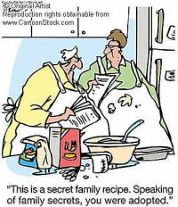
The Internet is Changing Adoption Forever
. . . How Profound Will the Impact Be?

Slide 9
The Good, the Bad and the Ugly:
Three Big Buckets and Many Smaller Ones
Adoption Practice: Promising babies, offering incentives, etc. Do ethical professionals stand a chance? Will the scams grow?
Adoption/foster care in the Courts: Judge decides on visitation, timing, etc. . . . then Mary logs onto Facebook.
Search and Reunion: Every day, in every way. So, what should professionals tell their clients? What should parents tell their children? What education and resources are needed?
More and More: New opportunities for hard-to-place children, educational resources, support groups.
InternetProjectAI@gmail.com

Slide 10
What Do Today’s Professionals
View as Ethical/Best Practices?
Preparation, counseling and representation of prospective parents and expectant mothers/fathers
Education and resources about openness/relationships
Transparency regarding payments and services
Non-coercive (including financial) procedures
Access to post-adoption resources for all parties
Supervision and boundaries for children’s safety when adopted from foster care
Will “practitioners” on the internet buy into these?

Slide 11
What’s Happening Out There . . .
Ethics Aren’t Just about Scams
There are reunions without counseling, supervision or, sometimes, even knowledge of the adoptive parents.
There are relationships with birth relatives that are unsupervised and, sometimes, unknown to parents.
Judicial orders – and safeguards – are being ignored.
There are practices that are dubious at best, practitioners who aren’t trained, laws that are antiquated, etc.
Some children’s safety – emotional, psychological and perhaps physical – almost certainly is being put at risk.
What else?

Slide 12

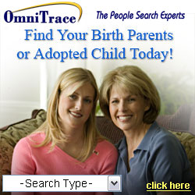
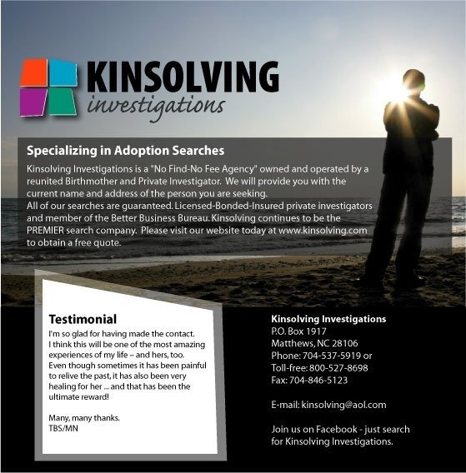
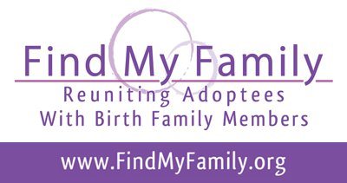
Welcome to the Internet:
How Hard is it To Find Someone?

Slide 13
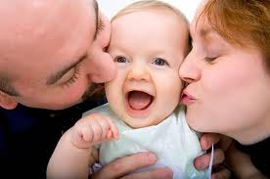
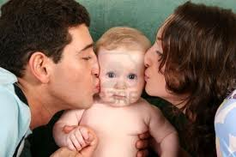
How Does Infant Adoption
Work on the Internet?
“Complete your domestic adoption, on average, within 3-12 months.” “We connect with states where birth parents cannot revoke consent.”
* Learn more about the safe alternative to abortion... Adoption.
* Financial assistance is available. * FREE housing is available.

Slide 14
Story after Story Like These
“I recently read a story in Time in which Mr. Pertman was quoted, talking about the phenomenon of birth parents and adopted children finding each other through social media. Last night, my 12 year old daughter’s birth family contacted her successfully through Facebook. We are devastated. She wants very much to meet them. … What advice and literature can you provide us to deal with this? It is living hell.”
“I had been looking for my mother and siblings, if I had them, for years and years. … Finally, through Facebook, I found them overnight and they have added immeasurable joy to my life. My adoptive family is still my `real’ family but now I have more.”

Slide 15
How Big a Deal is the Internet’s Impact …
And What Do We Need to Do?
Traditional adoption practice is probably at financial risk.
Era of secrecy and closure is probably nearing its end.
Era of the Extended Family of Adoption entering at hyperspeed.
Need research to shape best practices, offer knowledge and tools.
Need to develop information and training for professionals and parents to provide counseling, guidance, boundaries.
Need to update laws (ex., closed records), policies, practices.
What else? Regarding the Internet? To promote ethics-based best practices? To reduce the risk and reality of scams?

